Slide 1
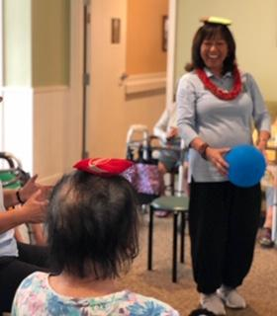
Tai Chi for Caregivers’ Brain Health and Wellness
Sara Tompkison, LCSW
GWEP Social Work Instructor
John A Burns School of Medicine - Department of Geriatric Medicine
Certified Tai Chi for Health Institute(TCHI) Instructor

Slide 2
1. Describe how Tai Chi can enhance brain health and improve cognitive function. 2. Identify two benefits of Tai Chi to decrease the risk of dementia. 3. Explain how Tai Chi can support the physical, emotional, social and spiritual wellness for family caregivers.
Learning Objectives:

Slide 3
What is Tai Chi?
1. Tai Chi is a mind-body exercise that originated in ancient China where it started as a martial art. 2. It is “ moving meditation” and includes a series of slow flowing movements to create harmony between the mind and body. 3. The choreographed movement patterns require visuospatial skills, rapid processing of information and memory.

Slide 4
Tai Chi Benefits for Brain Health
Tai Chi incorporates intentional physical movements with mental concentration to engage the brain’s regions responsible for cognition(e.g. thinking process), balance and coordination.
These slow and fluid moving tai chi forms can promote “neuroplasticity”. Neuroplasticity is the brain’s ability to reorganize itself by forming new neural connections and pathways throughout life.
Tai Chi strengthens neural connections to enable learning, bolster cognitive resilience, and supports healthy aging by enhancing the brain’s ability to adapt to new challenges.

Slide 5
Tai Chi Benefits for Brain Health (Cont’d)
Tai Chi can support memory function, mental clarity and enhance better information processing. Reducing the risk of cognitive impairment may also build resilience against age related brain diseases.
Regular tai chi practice provides long-term cognitive and physical benefits, contributing to overall wellness and improved quality of life.
More research is needed to evaluate how Tai Chi with music can be used as a behavioral intervention for persons living with dementia.

Slide 6
Tai Chi Styles
Chen is the oldest with fast and explosive movements; combined with slow and gentle movements.
Yang most popular form and characterized by gentle, large frame movements.
Hao Style focuses on internal force(lesser known style).
Wu style is characterized by softness and emphasis is on re-directing incoming force with a slightly forward leaning posture.
Sun style is the youngest of all the forms created in the early 1900’s. This style has lots of Qigong movements and is characterized by lively steps, and has a slightly higher stance. Tai Chi for Arthritis and Falls Prevention is based on Sun style developed by Dr. Paul Lam, Tai Chi Health Care Institute.

Slide 7
Tai Chi Principles
Notes:
Mention the 5 styles of Tai Chi
7

Slide 8
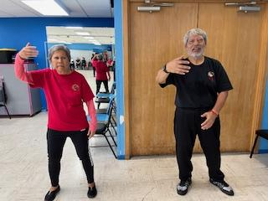
Breathing
Avoid holding your breath while moving.
Inhale through through your nose; Exhale through your nose.
Breathe with focus and using your DanTian (belly breathing).
Women place your right hand below your navel; the left hand on top of the right hand.
Men place your left hand below your navel; the right hand on top of the left hand.

Slide 9
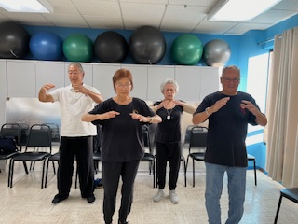
Growing Your Chi Energy
Start by inhaling and lift your arms up as if your are pulling energy toward the heavens.
Then exhale, turning your palms down and slowly pushing the energy toward the earth.
Let’s do this a few more times.

Slide 10
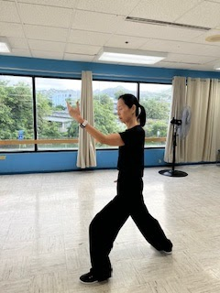
Body Posture
Maintain an upright posture. Studies have shown that good
posture strengthens the deep stabilizer muscles which support
the spine.
What’s more, when you are upright you feel stronger and more positive.
Qi flows better in a well aligned body.
Balance is an essential part of Tai Chi. Like nature, we are happier and healthier when in harmony.

Slide 11
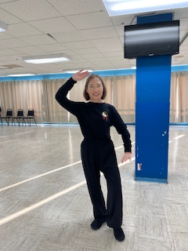
Outward Movement
Tai Chi movements are slow so that you can be mindful
of them. Allow your movements to flow continuously like water
in the ocean.
The continual flow gathers inner energy like hydraulic power, growing as it
flows.
Move as though you’re moving against a gentle resistance with every
movement to generate a soft inner power.

Slide 12
Why Learn and Practice Tai Chi?
Improves brain health and wellness - to improve attention span; helps promote a calm and relaxed mood. Provides long term cognitive and physical benefits.
Anyone can do it – People of any age with any level of fitness can practice Tai Chi. It is low impact and safe when practiced correctly.
Cultivates one’s Life Force - The ultimate purpose of Tai Chi is to grow your Qi(pronounced chee) or inner life energy to flow smoothly and powerfully through your entire body.
Notes:
This is a spiritual as much as a physical experience.

Slide 13
Warm Ups, Basic 6 Sun Style
and Cool Downs
Tai Chi will not only help you to remember your movements, but will create a lifelong journey of integrating your body, mind and spirit.
Notes:
For the mind to control the body, it also means the mind is calm, and has great clarity and concentration.

Slide 14
Xie Xie (Thank You) and Questions
Luna at Hale Ku’ike Pali

